Slide 1
Serious Firewood
Sign out

Slide 2
Component Implementation
Finding the necessary materials gathered in the forest (IE. logs)
To give the player the freedom to find objects and possibly find them within the time limit
Scene transition from MainScene to BuildingScene where the materials are dragged and clipped to mimic the firewood
To demonstrate building skills to the player

Slide 3
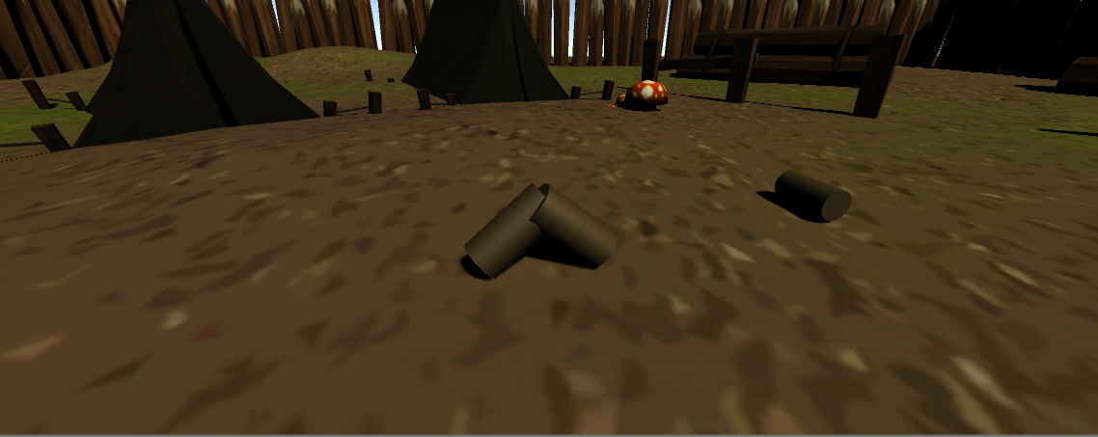
Fire Building
The player takes the pieces of tinder they found to build the fire.
The tinder is dragged around using the mouse
Tinder becomes locked in place once it is in the proper location.

Slide 4
Challenges
Time constraints
Working at home causes communication issues
The time leading up to development has been busy

Slide 5
Remaining Features
Time limit
Weather implementation (IE. rain/storm)
UI
Collections
Point system

Slide 6
Questions?

